Slide 1

Generative Adversarial Networks (GANs)
Notes:
‹#›

Slide 2
Agenda
What are GANs?
How does a GAN work?
Applications of GANs.

Slide 3
What is a GAN?
GAN = generative adversarial network.
GANs are used to generate images that cannot be distinguished from real images.
GANs are an approach taken in generative modeling that uses deep neural networks.
Structured algorithms use two neural networks to generate new synthetic images that appear to be the same as the real images.

Slide 4
How Does a GAN Work?
Two machine learning models:
Generator creates the images based on provided parameters.
Generator randomly selects values from input parameters that come in the form of ranges.
Generator undergoes training to select proper values.
Discriminator decides if the images are fake or real.
Discriminator is trained with real and artificial images.
Fails at first but improves as a greater number of decent samples are provided.
These two models compete against each other, which is why they are described as adversarial.

Slide 5
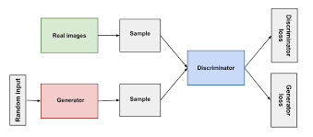
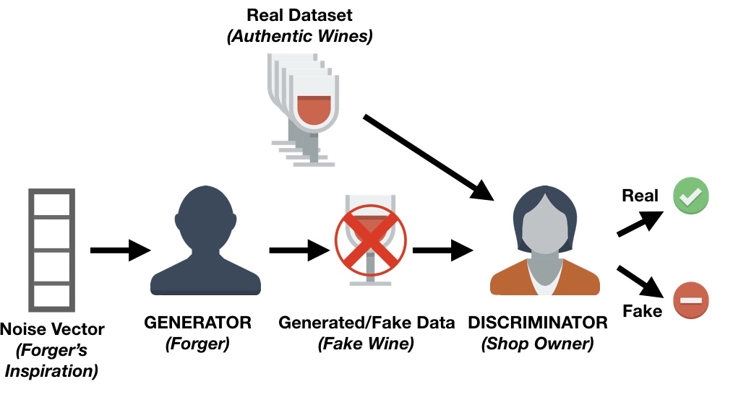
How Does a GAN Work?

Slide 6
Applications of GANs
GANs can be used to create deepfakes which are fake images or fake videos that have been “created and modified.”
Fake videos created and modified by GANs are used for real-time video manipulation.
The machine learning algorithm can map the mouth of an actor onto another individual to change what that individual stated in a video.
GANs are also being used to identify deepfakes and separate the fake images or videos from the real ones.

